Slide 1

Sentiment Analysis Using NLP
Maitreyi Phadke(22106007)
Gauri Ramekar(22106068)
Arya Raut(22106075)
Chinmay Sawant(22106017)
Project Guide
Prof.Mahesh Pawaskar

Slide 2

Outline
Introduction
Literature Survey of the Existing Systems
Limitations of the Existing Systems
Problem Statement
Proposed System Design
Framework/Algorithm
Technologies Stack for Proposed System
Details of Database / Input to the System
Implementation(Partial)
Conclusion
References

Slide 3
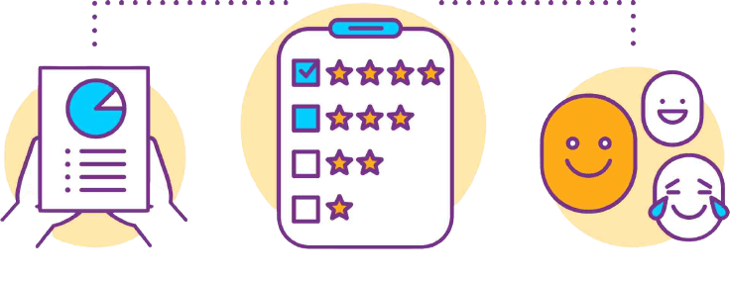
SENTIMENT ANALYSIS USING NLP

Slide 4

INTRODUCTION-
Sentiment analysis, also known as opinion mining, is a Natural Language Processing (NLP)
technique used to determine the emotional tone or sentiment expressed in a piece of text.
It involves categorizing text data into positive or negative sentiments to judge
the author's opinion or emotional state.
Objectives: To build a sentiment analysis system for classifying sentiments in
feedback and social media trends.
Real-world Observation: Sentiment analysis is essential for companies to
understand customer feedback and perception.
Motivation: The growing importance of customer feedback in product
strategy and development.

Slide 5

Literature Survey of the Existing Systems-
1: "Sentiment Analysis Is a Big Suitcase" (IEEE XPLORE 2020)
Discusses the complexity of sentiment analysis in NLP, requiring
multiple layers of understanding​.
2: "State of the Art: A Review of Sentiment Analysis Based on Sequential
Transfer Learning" (IEEE XPLORE 2020)
Explores the background and applications of sequential transfer learning
in sentiment analysis​.
3: "A Survey of Knowledge Enhanced Pre-Trained Language Models"(IEEE XPLORE 2020)
Reviews Knowledge Enhanced Pre-trained Language Models (KE-PLMs)
and their use in NLP​.
4: "Sentiment Analysis of Product Reviews: A Review" (IEEE XPLORE 2017)
Categorizes sentiment analysis methods and compares performance,
noting that SVM outperforms Naive Bayes and Maximum Entropy in
online review analysis​.
5: "A Review of Natural Language Processing Techniques for Sentiment
Analysis Using Pre-Trained Models" (IEEE XPLORE 2017)
Gives us the overall review of NLP

Slide 6

Limitations of Existing Systems -
Limited Dataset Diversity
Contextual Ambiguity
Language Variability
Scalability Issues
Model Overfitting
Lack of Domain Adaptation
Inconsistent Sentiment Classification
Integration Challenges
Computational Resource Demands
Privacy Concerns

Slide 7

PROBLEM STATEMENT-
Developing a sentiment analysis system to accurately classify text from diverse sources such as customer reviews(amazon), social media, and news articles into positive or negative sentiments. The system must handle contextual nuances, adapt to language variability, and scale efficiently to support informed decision-making and strategic planning.

Slide 8
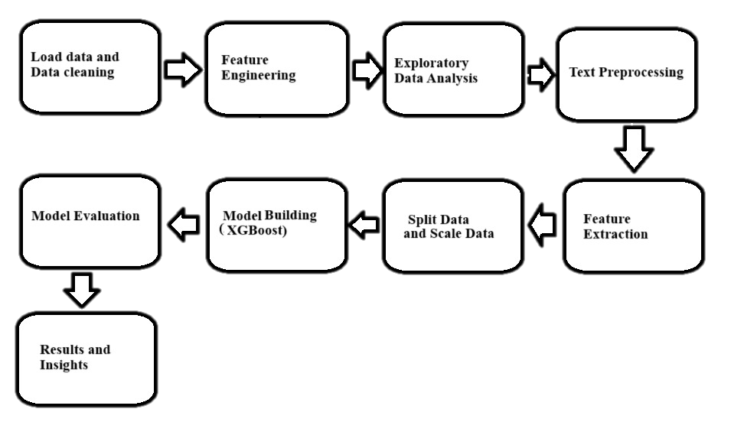

Proposed System Design -

Slide 9

Framework/Algorithm -
Load Data: Read dataset from “amazon_alexa.tsv”. Handle file path and delimiter (tab-separated).
Data Cleaning: Drop rows with null values in 'verified_reviews’. Create 'length' column for review length.
Feature Engineering: Analyze distributions (rating, feedback, variation). Visualize review length distribution.
EDA: Plot bar and pie charts for ratings and feedback distribution. Generate word clouds for overall and categorized reviews.
Text Preprocessing: Remove non-alphabet characters from reviews. Convert text to lowercase. Apply stemming and remove stopwords.
Feature Extraction:Use `CountVectorizer` to convert text data to numerical features. Fit and transform the data into a feature matrix.
Split Data(Train/Test): Split data into training (70%) and testing (30%) sets.
Scale Data: Normalize feature values using `MinMaxScaler`
Model Building: Train XGBoost Classifier on the scaled training data. Other models like
Decision Tree and Random Forest could also be tested.
Model evaluation: Valuate model accuracy on both training and test sets.
Generate confusion matrix and visualize with ‘Confusion Matrix’.

Slide 10

Technology Stack for Proposed System -
Python
Scikit-Learn
XGBoost
NLTK(Natural Language Toolkit)
CountVectorizer
MinMaxScaler
Matplotlib and Seaborn
Jupyter Notebook

Slide 11

Details of Database / Input to the System -
This dataset consists of a nearly 3000 Amazon customer reviews (input text), star ratings, date of review, variant and feedback of various amazon Alexa products like Alexa Echo, Echo dots, Alexa Firesticks etc. for learning how to train Machine for sentiment analysis.
What you can do with this Data ?
We can use this data to analyze Amazon’s Alexa product ; discover insights into consumer reviews and assist with machine learning models.We can also train your machine models for sentiment analysis and analyze customer reviews how many positive reviews ? and how many negative reviews ?
Source: Extracted from Amazon's website
Dataset link -
https://www.kaggle.com/datasets/sid321axn/amazon-alexa-reviews

Slide 12
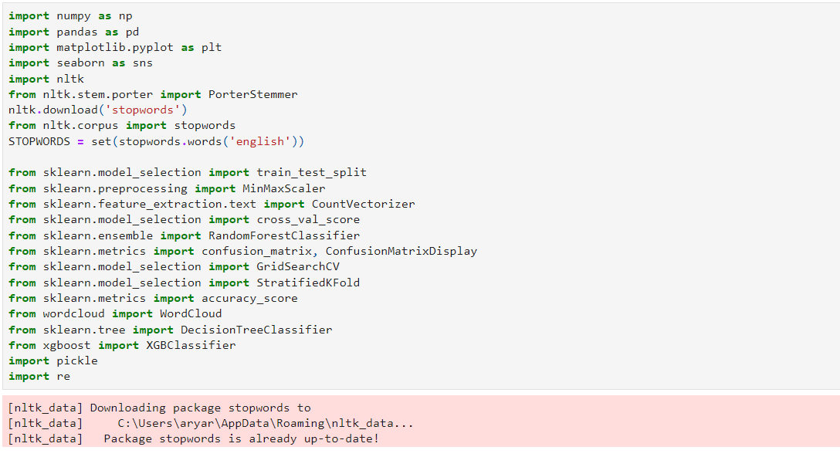
Implementation
(Screenshots of implementation 50%) -

Slide 13
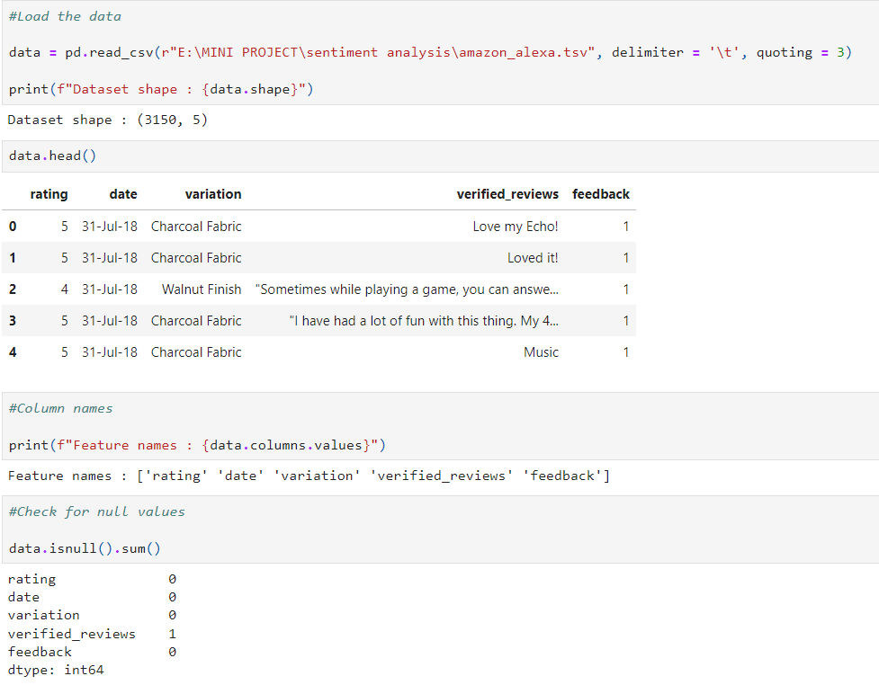

Slide 14
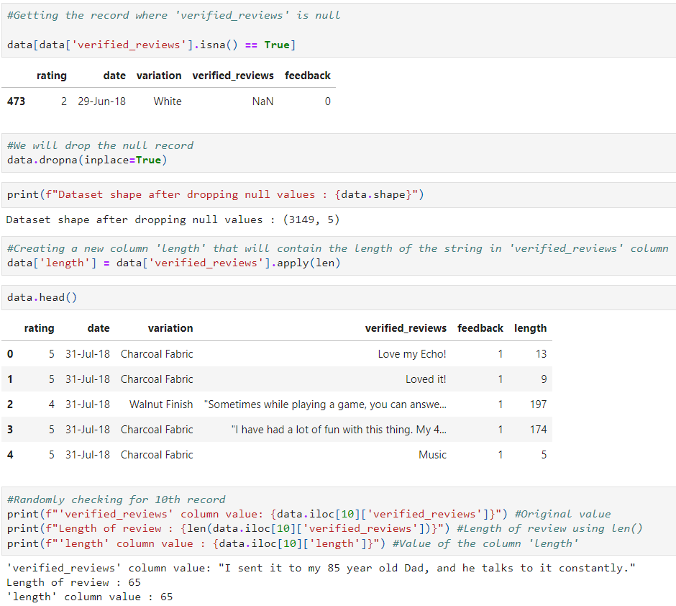

Slide 15
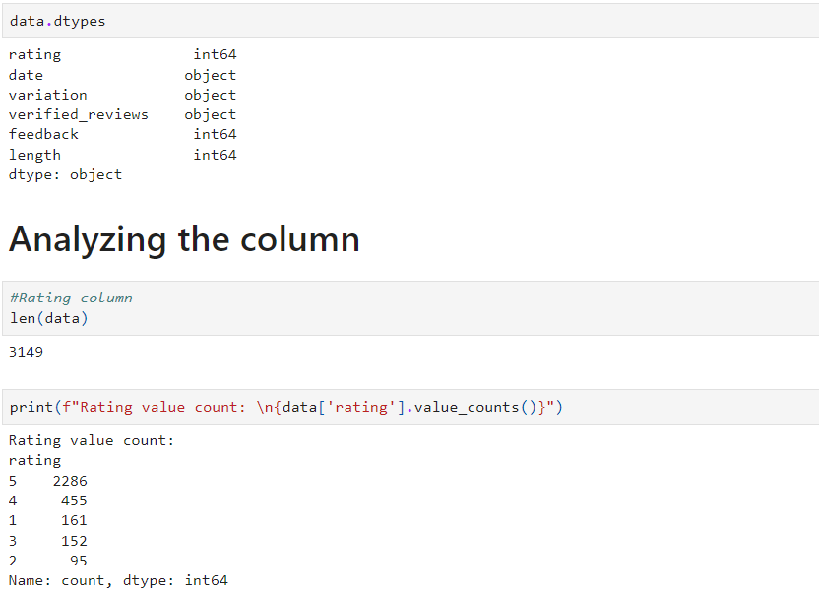

Slide 16
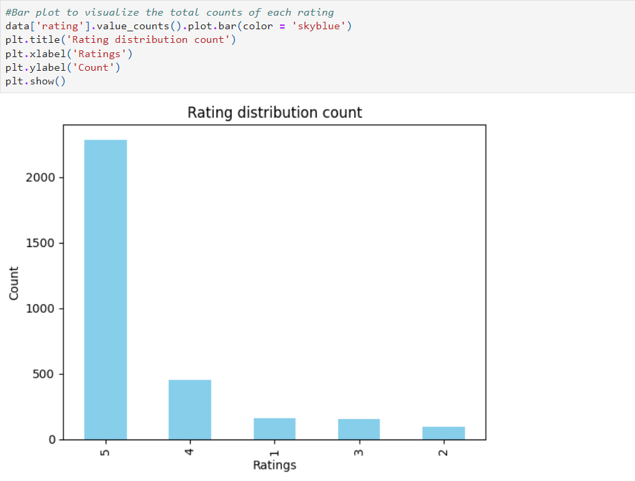

Slide 17
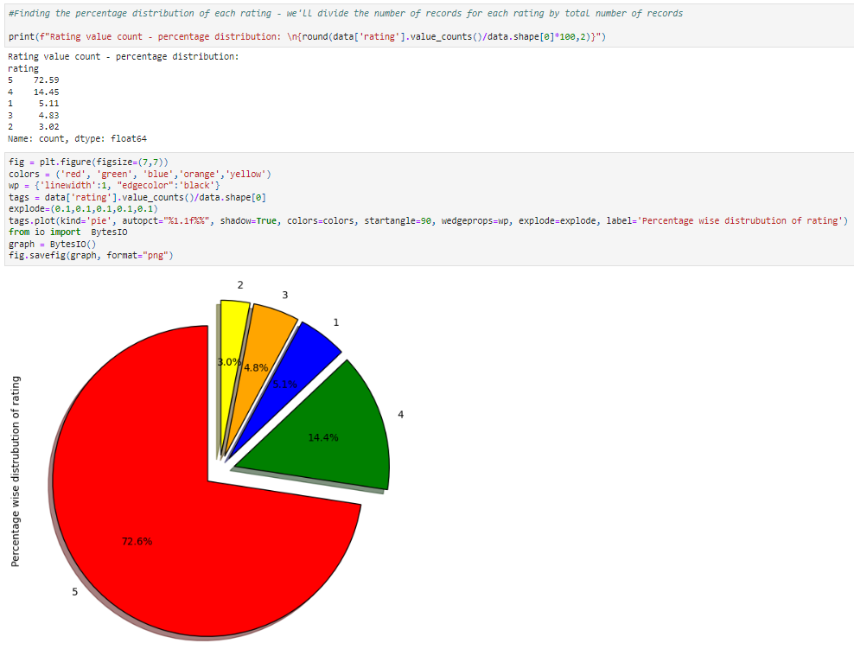

Slide 18
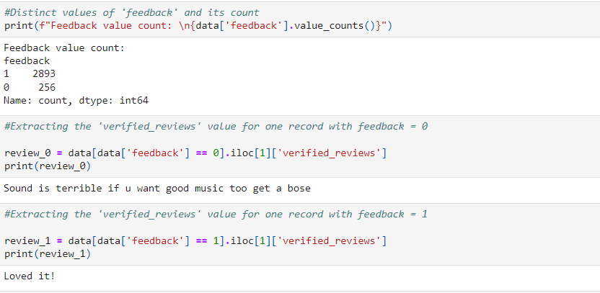

Slide 19
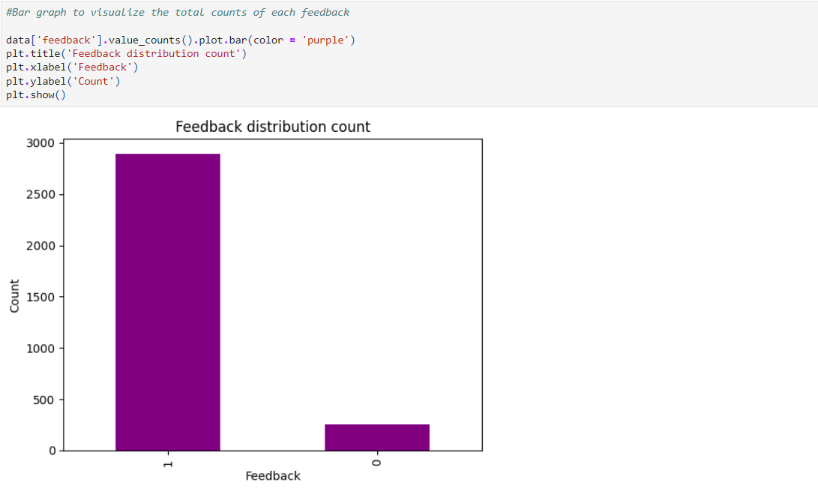

Slide 20
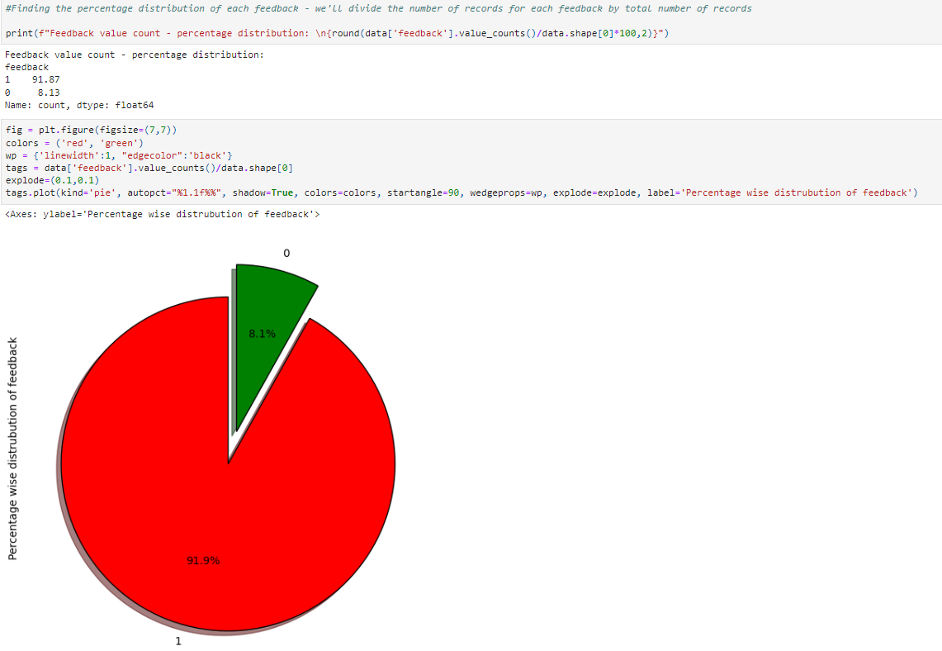

Slide 21
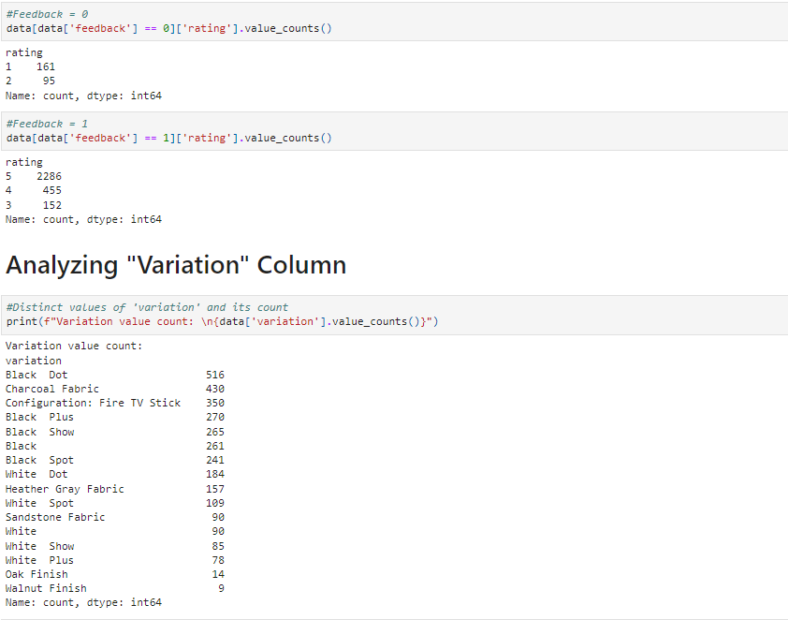

Slide 22
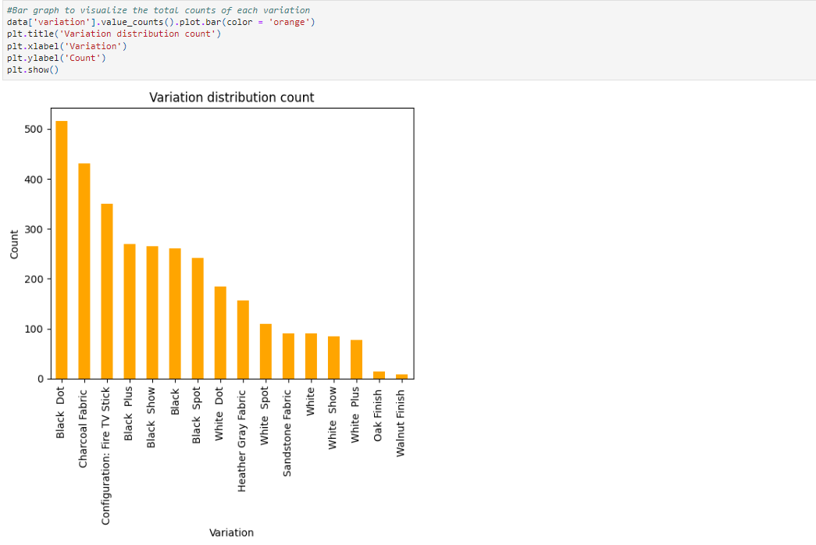

Slide 23
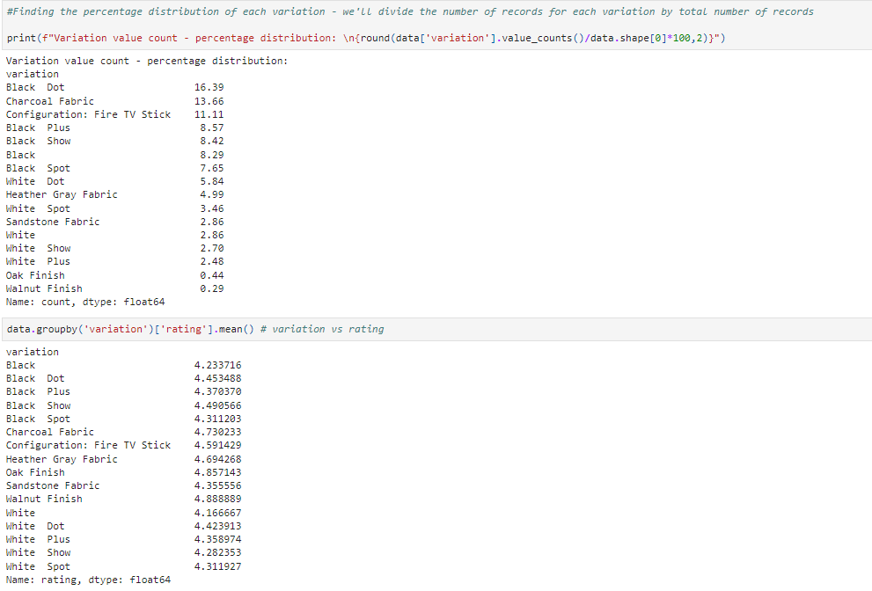

Slide 24
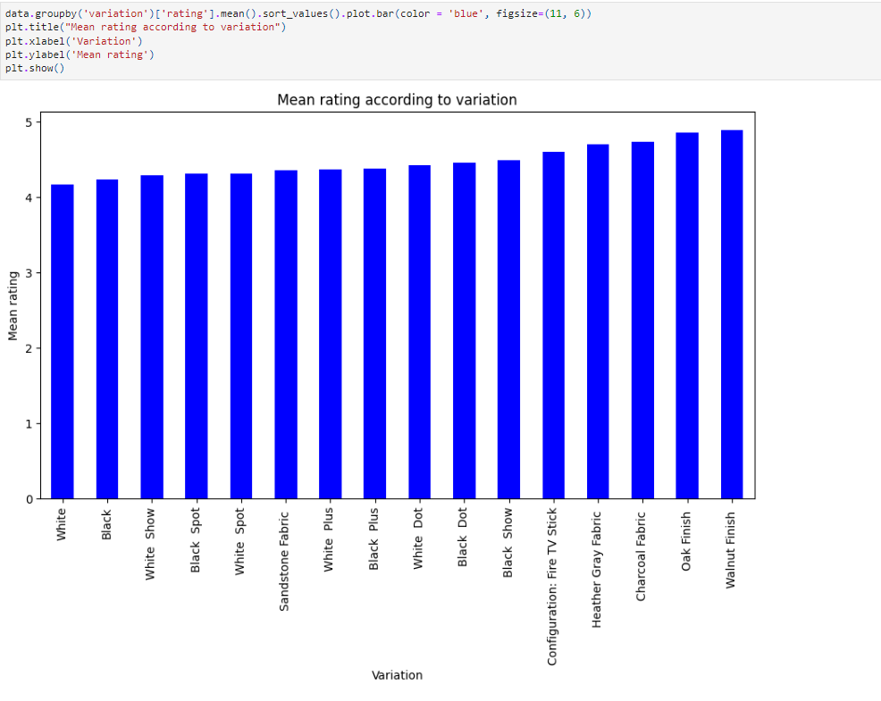

Slide 25
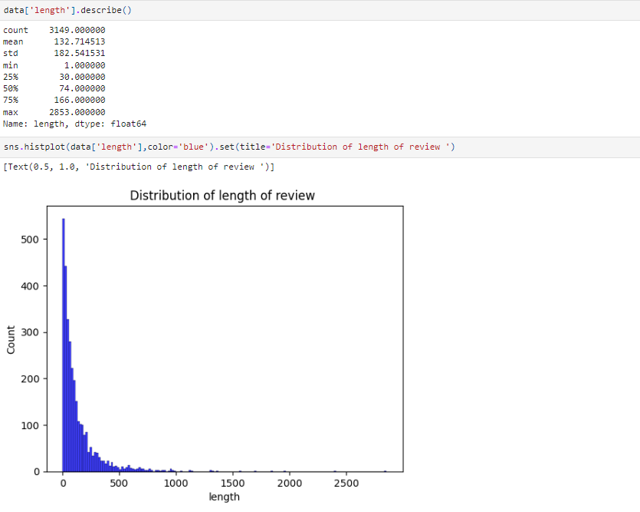

Slide 26
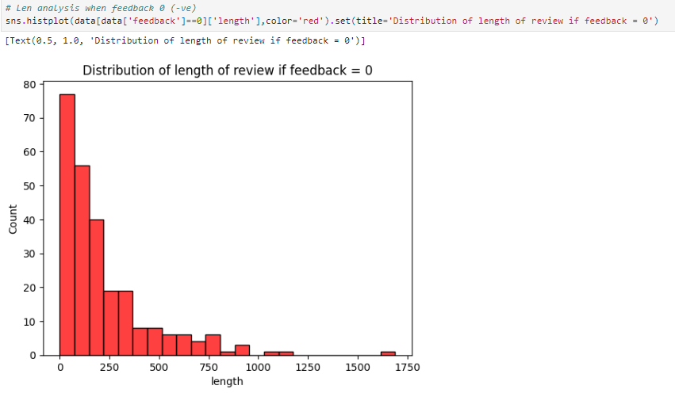

Slide 27
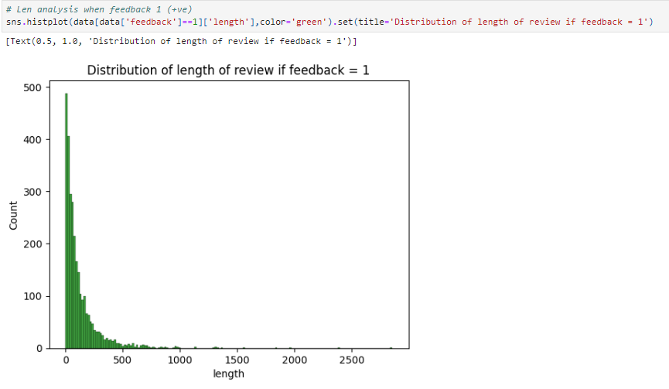

Slide 28
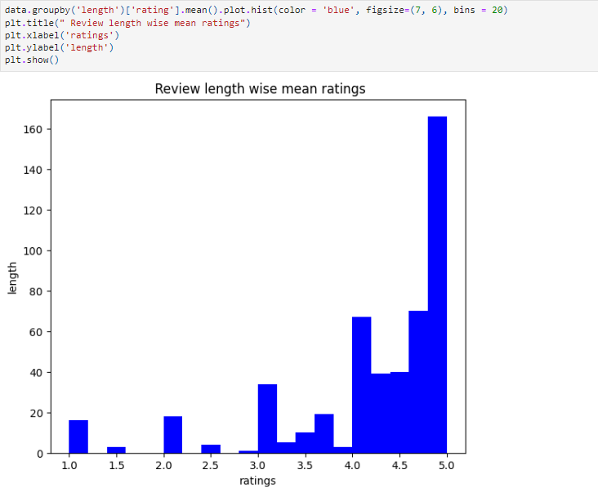

Slide 29
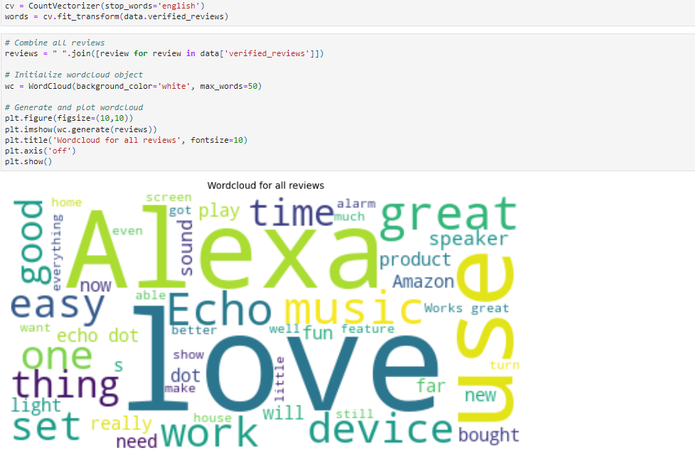

Slide 30
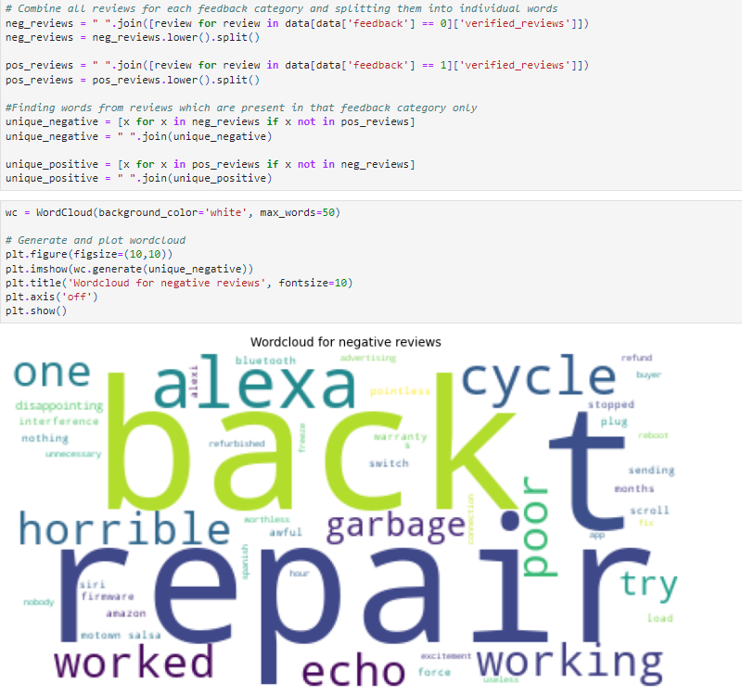

Slide 31
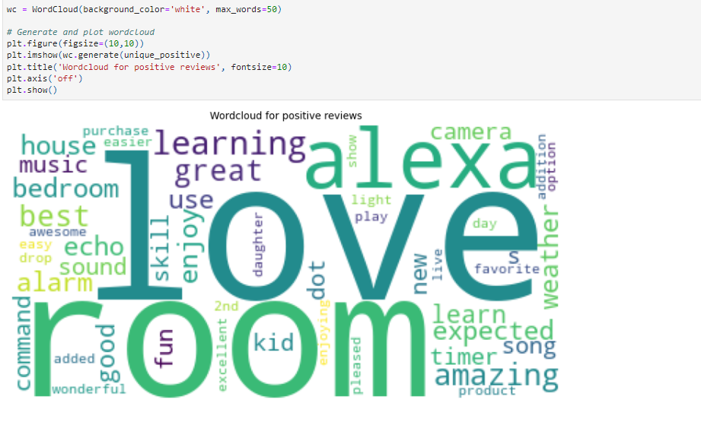

Slide 32
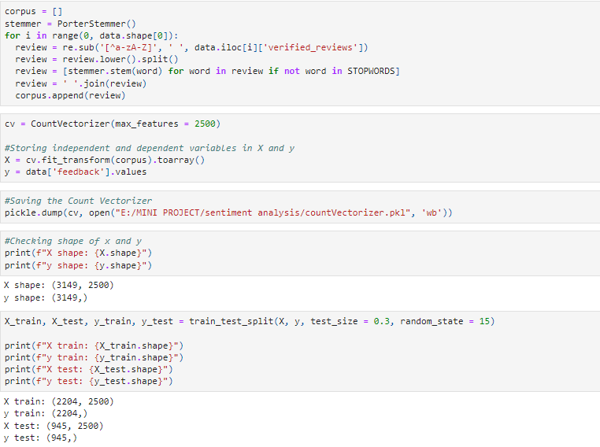

Slide 33
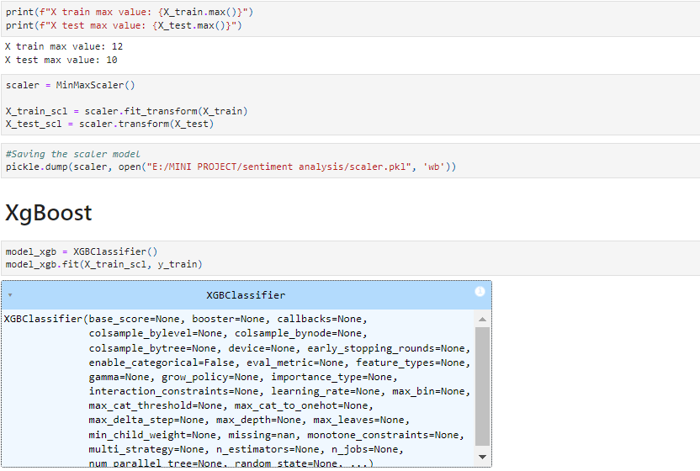

Slide 34
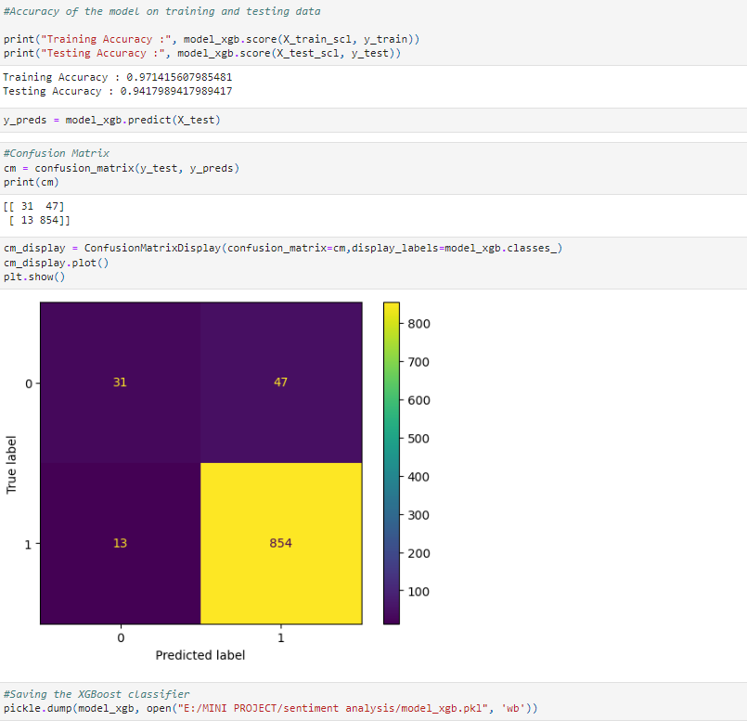

Slide 35

CONCLUSION-
Thus, It extracts emotional insights from text, empowering organizations to adapt and strategize effectively based on public sentiment and feedback.

Slide 36

References -
Sentiment Analysis Is a Big Suitcase (IEEE XPLORE 2020)- (Cambria, Erik, Soujanya Poria, Alexander Gelbukh, Mike Thelwal)
State of the art: a review of sentiment analysis based on sequential transfer learning (IEEE XPLORE 2020) – (Chan, Jireh Yi-Le, Khean Thye Bea, Steven Mun Hong Leow, Seuk Wai Phoong, Wai Khuen Cheng )
A Survey of Knowledge Enhanced Pre-Trained Language Models (IEEE XPLORE 2020)-(Hu, Linmei, Zeyi Liu, Ziwang Zhao, Lei Hou, Liqiang Nie, and Juanzi Li )-
Sentiment analysis of product reviews: A review (IEEE XPLORE 2017) (Shivaprasad, T. K. Jyoti Shetty)
A Review of Natural Language Processing Techniques for Sentiment Analysis using Pre-trained Models (IEEE XPLORE 2017) – (Cambria, Erik, Soujanya Poria, Alexander Gelbukh, Mike Thelwall)

Slide 37
THANK YOU !

